Slide 1



Skylark Curriculum Update

Slide 2
Aims and outline
National
Long/Medium-term planning
Children’s work

Slide 3
Why have we made this change?
Inspectors will also evaluate how leaders ‘construct a curriculum that is ambitious and designed to give all learners...the knowledge and cultural capital they need to succeed in life [while ensuring] teaching is designed to help learners to remember in the long term the content they have been taught and to integrate new knowledge into larger concepts’ (Ofsted, May 2019, pg. 9 and 10).
Pupils, nationally, had not been allowed opportunities to sufficiently and fully explore and hone the knowledge and skills required for further study in the ‘Foundation’ subjects (History, Geography and the Arts) due to an improperly configured curriculum programme.
We truly believe that our bespoke Skylark Curriculum will ensure that children have a curriculum that is engaging and have ‘real’ opportunities within our local communities.

Slide 4
Where we are so far
T1/2 – Discover History focus
  Treasure (2020); Conflict (2021).
  Planned, taught and assessed according to our new curriculum model twice.
Rest of the year = Explore (T3/4) and Create (T5/6)
  Home and Landscape
  This year = Water (Explore) & Portrait (Create)

Slide 5
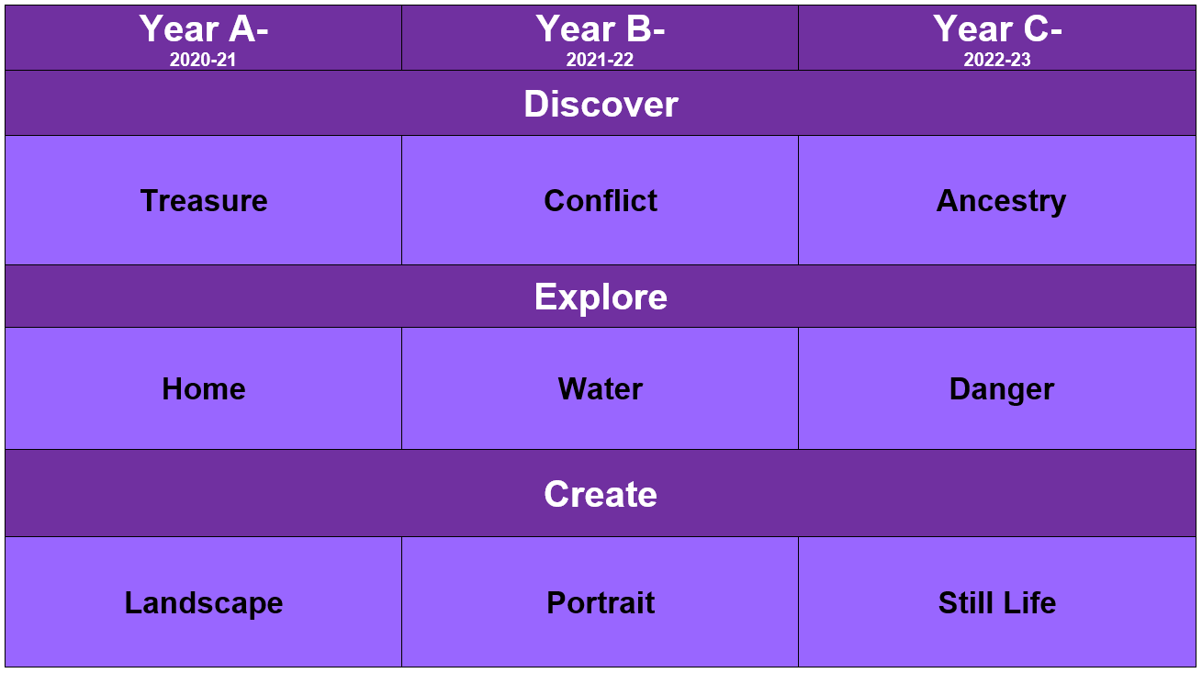
Our 3-year cycle

Slide 6
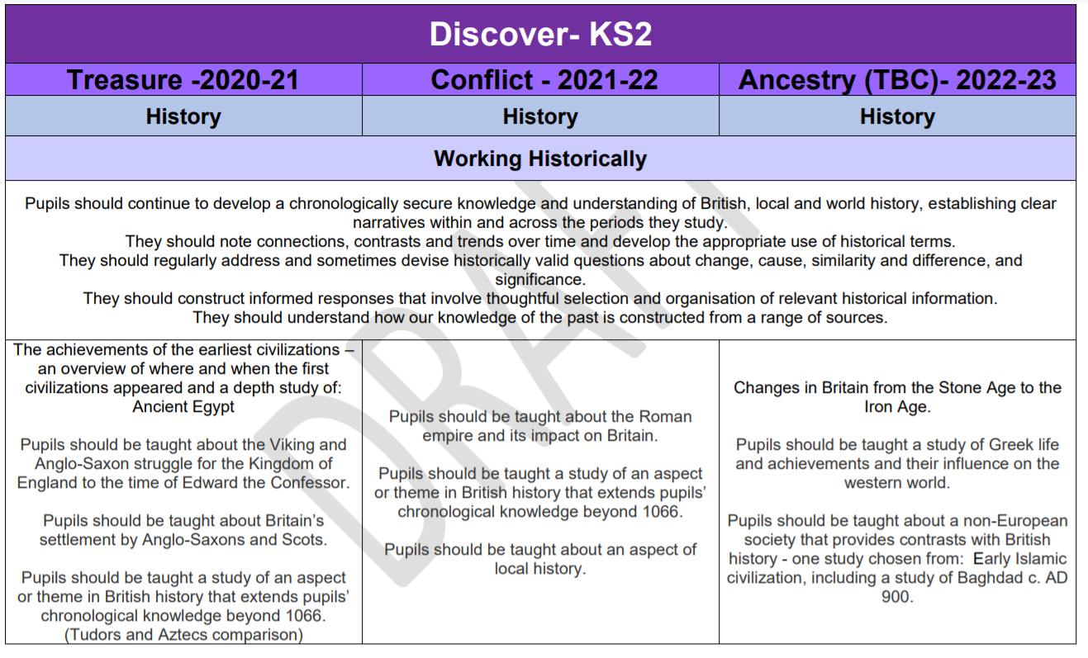




How skills are taught across the cycle
Derived from the curriculum
Spread skills throughout 3-year cycle
Some skills are always taught, such as chronology, source analysis (etc.)

Slide 7
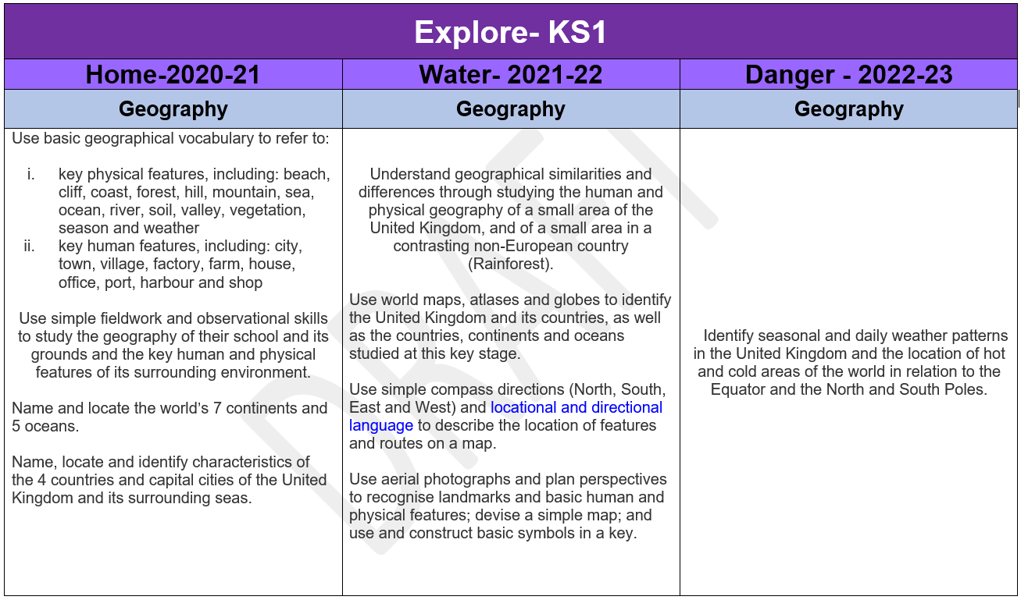
Explore – Geography and DT

Slide 8
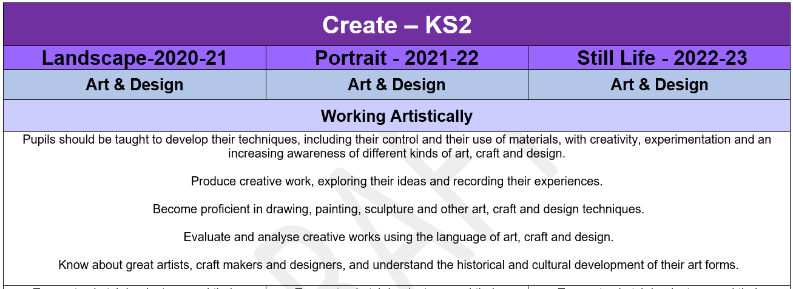
Create – Arts (Music, Dance, Drama)

Slide 9
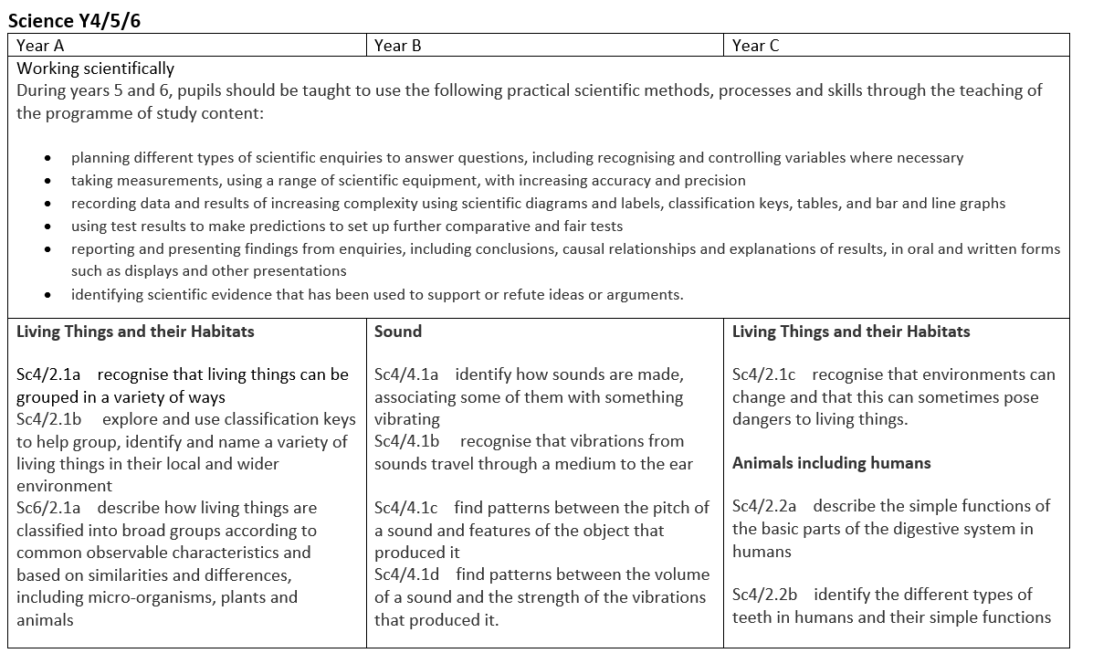
Science – complementary topics

Slide 10
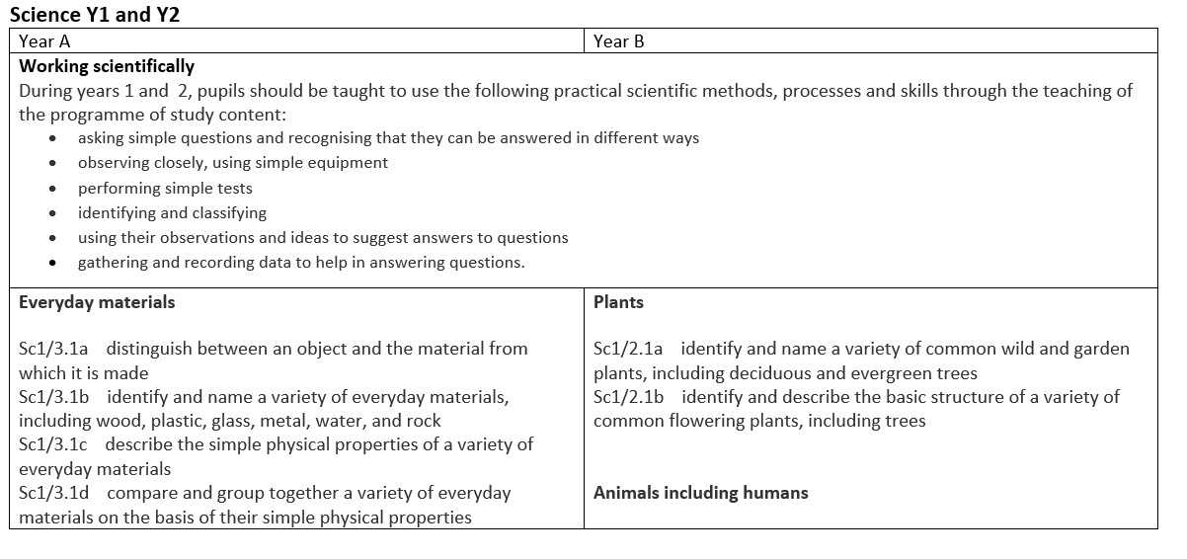
Science continued

Slide 11
EYFS links
The new curriculum takes on more of the principles of the EYFS curriculum:
  It’s more project-based
  Its subjects aren’t strictly partitioned and divided – there are more links between them
  This allows for easier planning of content in our Year R/1 mixed-age Hedgehogs Class

Slide 12
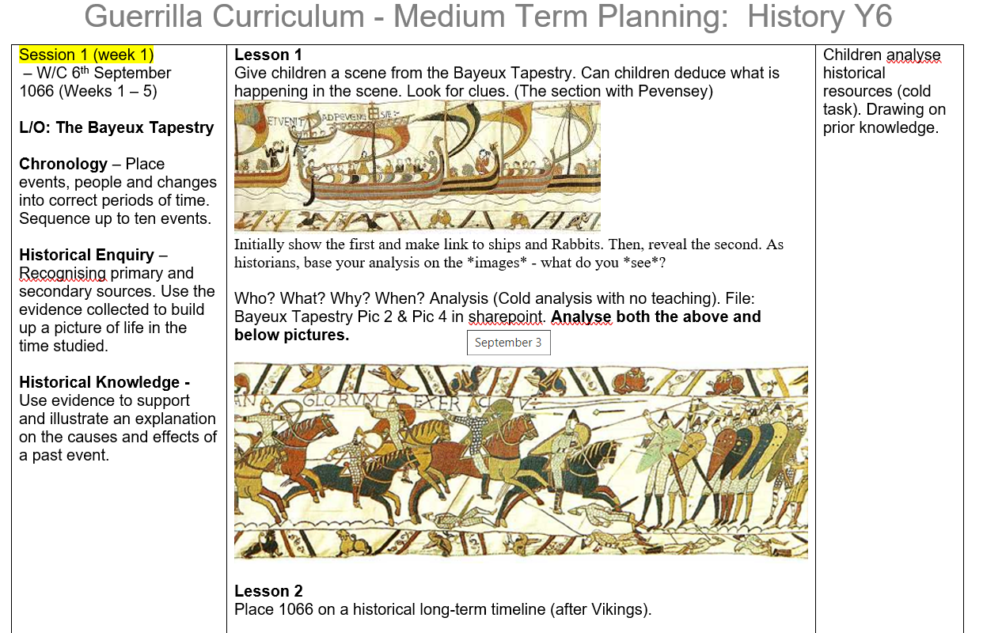
Medium-term planning

Slide 13
Children’s work
“You get focus on each project so you know that area better” - Lola
“I loved doing create because you got to use your imagination” - Roxy
from Year 6 pupils – discussing:
  Differences in curriculum
  Its joined-up approach
  How it can be more enjoyable
  Discuss Battle of Hastings project
  Q & A-
“I enjoy the new way of writing” - Esme

Slide 14
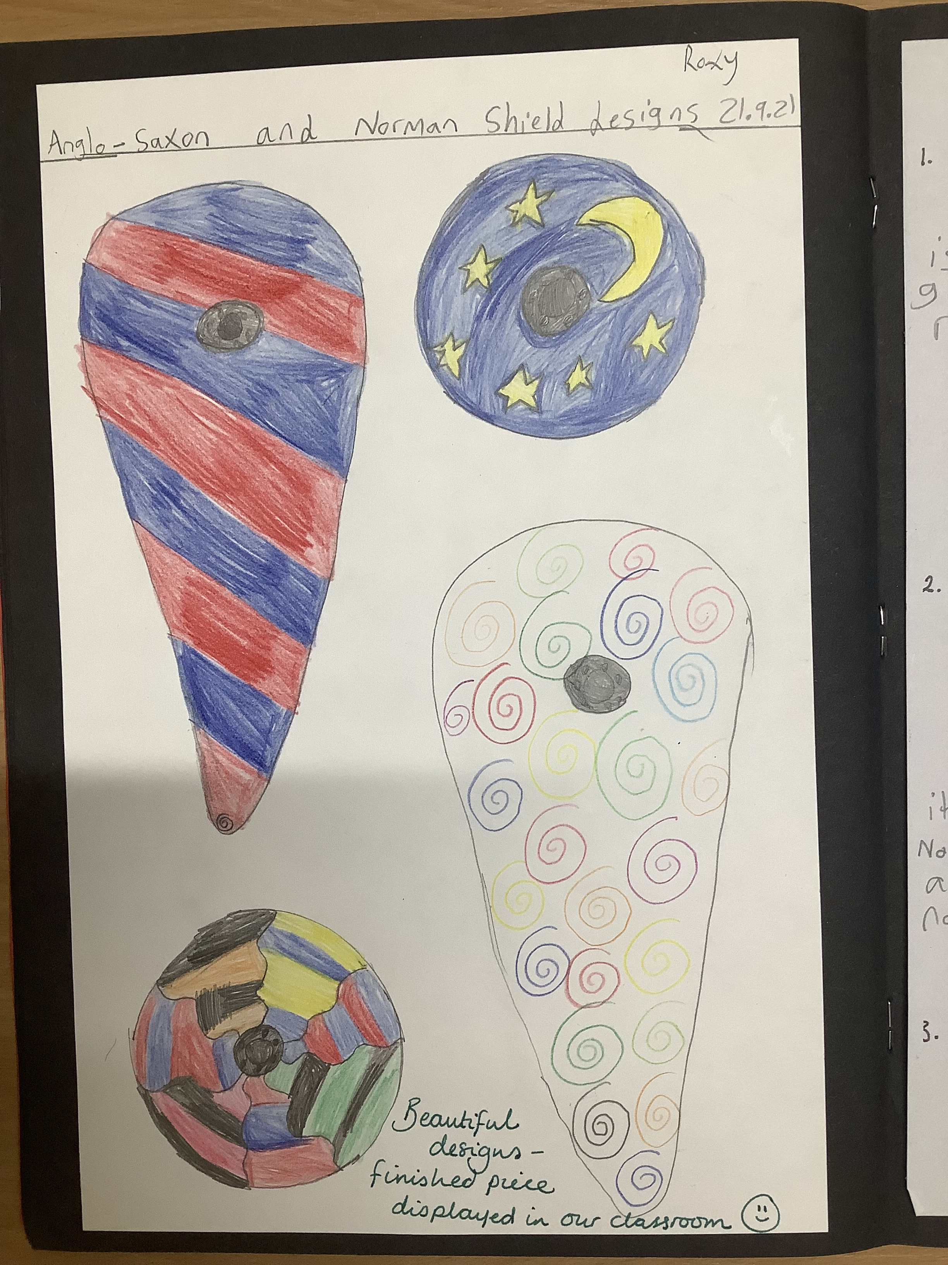
Year 6’s books and Feedback- Roxy
I enjoyed going to Battle Abby- we learnt more facts about the battle of Hastings.
In our discover project we still do D & T.

Slide 15
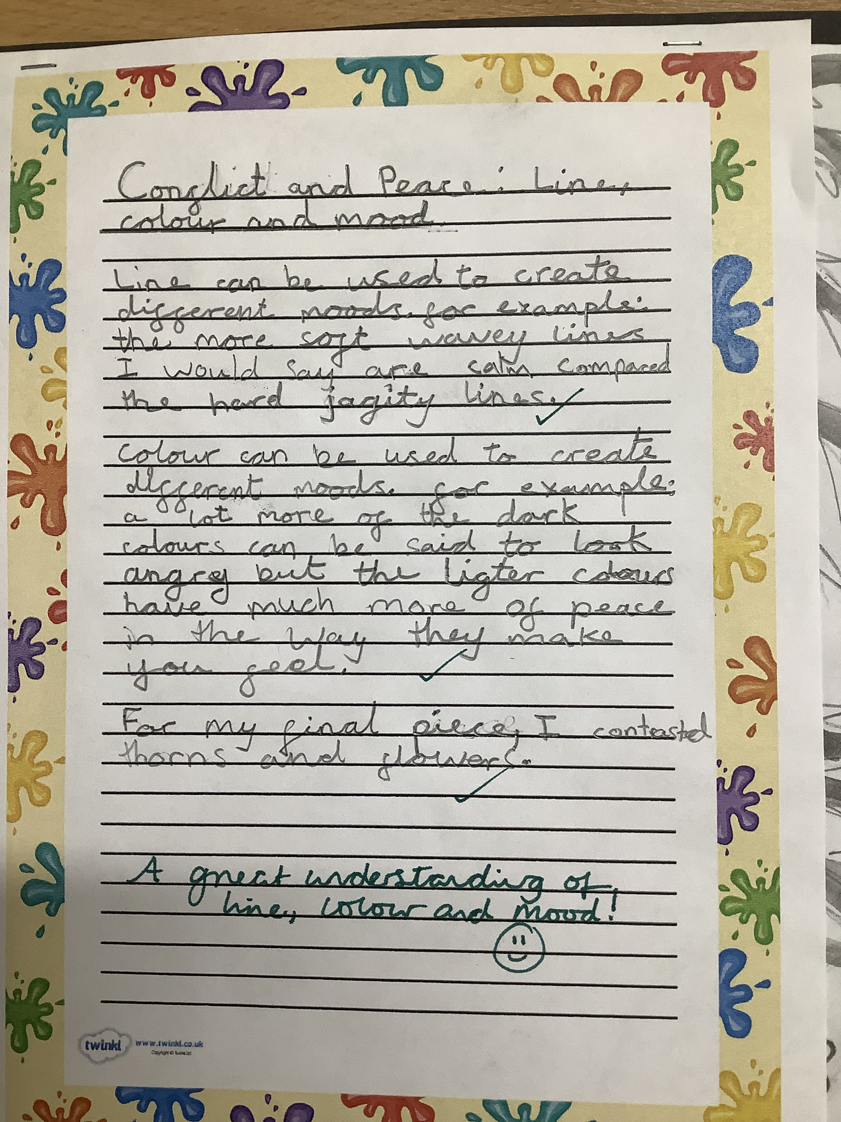
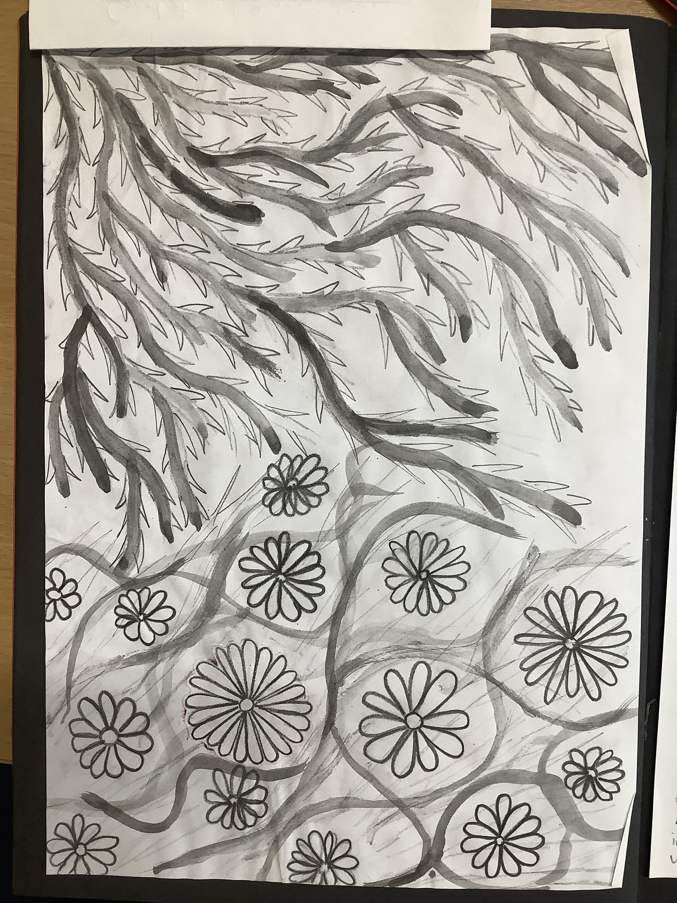
Year 6’s books and Feedback- Esme
We have pen pals in Paris and we write to them!
In our discover project we still do art.
We do analysis in all our projects.

Slide 16
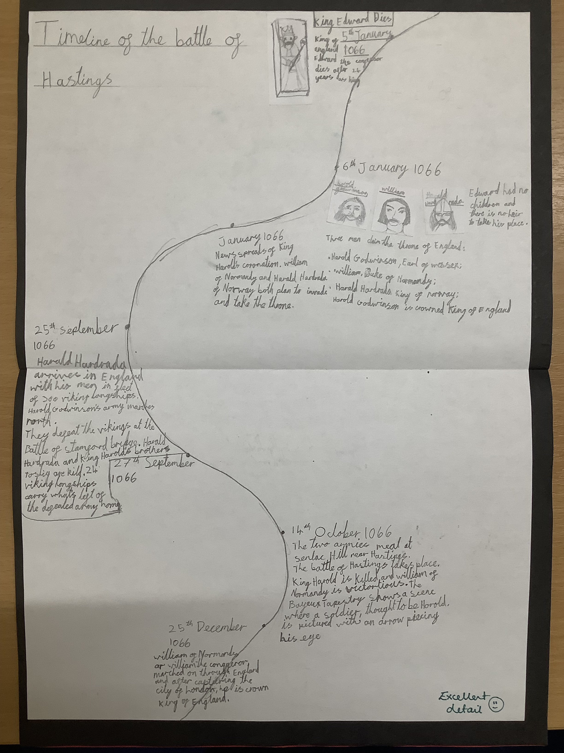
Year 6’s books and Feedback- Lola
Teachers from other schools came and spoke to us about the different subjects- we got to say what we like and disliked.
We do STEM days! Science, Technology, Engineering and Maths

Slide 17

Year 6 Q & A

Slide 18
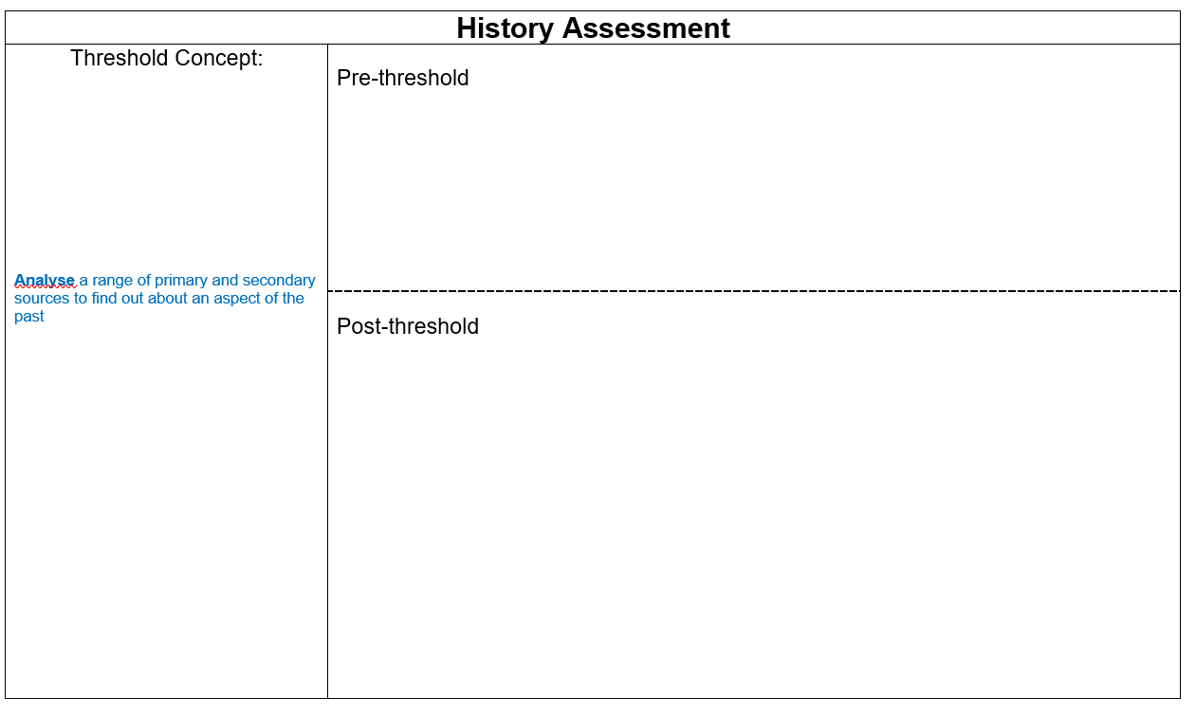
Assessment
How we assess and record children’s progress
We also regularly poll our School Council to see if pupils are enjoying their projects!

Slide 19
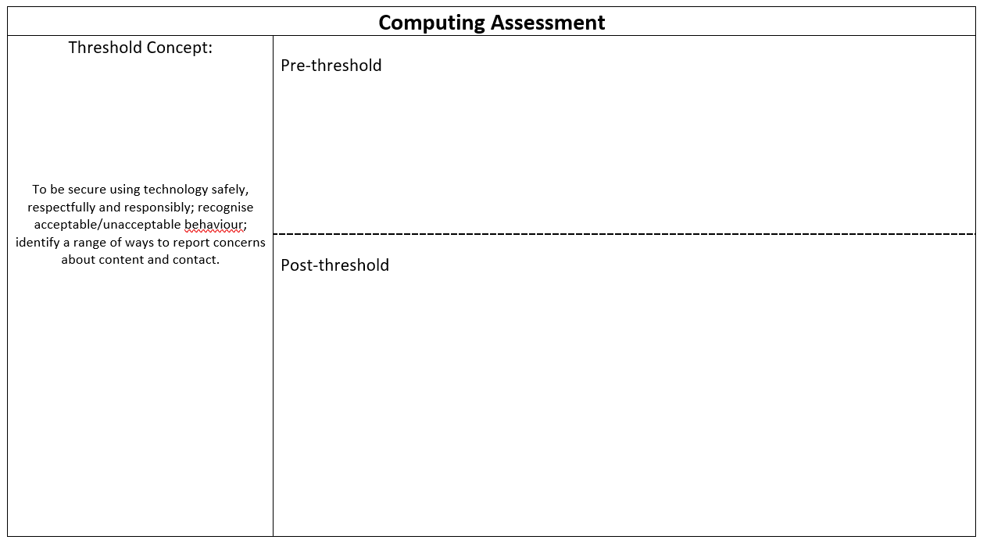
Newest updates
Assessing children – via pre/post-threshold – for Computing

Slide 20

Any questions and thanks

