Slide 2
Maths Mastery Update
Wednesday 10th November 2021

Slide 3
Today’s Aims
• Understand what the ‘Maths Mastery’ approach is.
• How we use the Mastery approach to guide our teaching of Maths at Hamsey.

Slide 4
What is mastery?
Mastering maths means pupils acquire a deep, long-term, secure and adaptable understanding of the subject.
Teaching maths for mastery involves employing approaches that help pupils to develop a deep and secure knowledge and understanding of mathematics at each stage of their learning, so that by the end of every school year or Key Stage, pupils will have acquired mastery of the mathematical facts and concepts they’ve been exposed to, equipping them to move on confidently and securely to more advanced material. Charlie Stripp, Director NCETM, 2016

Slide 5
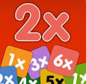
What does a Maths Mastery lesson look like?
A typical Maths mastery lesson is led by the teacher, with all of the pupils in the class working together on the same tasks at the same time. The pace of the class is governed by the children, giving them time to revisit key concepts frequently throughout the lesson.
There’s a mixture of short tasks, explanation, demonstration and discussion – and a lot of practice to help reinforce children’s learning. There is a focus on mathematical vocabulary.
Children are also expected to learn key maths facts like times tables and addition facts by heart to free up working memory and give them the mental space to focus on new concepts.
The lesson structure begins with revisiting previously taught concepts to ensure children feel confident.
New learning is introduced and children are encouraged to see connections with previous learning.
The children can then move onto the extension task and challenge task- when they are ready.

Slide 6
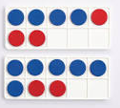
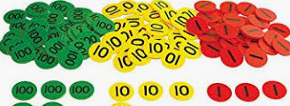
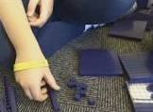
How are resources used?
Children use objects and pictures to physically represent mathematical concepts (the concrete > pictorial > abstract (CPA) approach), alongside numbers and symbols – for example, using Lego bricks to add and subtract numbers. This helps them visualise abstract ideas, and as they become more proficient, they will gradually stop relying on physical props.
EXAMPLES

Slide 8
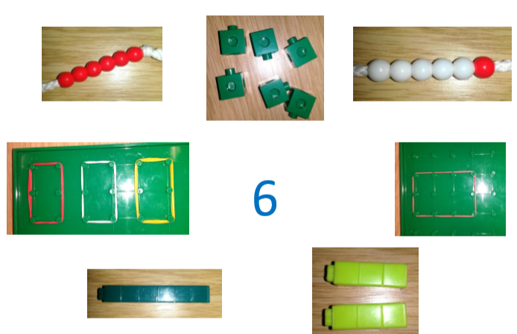
These are all different representations of 6!
We might ask children ‘What do these pictures represent?’
‘How do you know?’

Slide 9
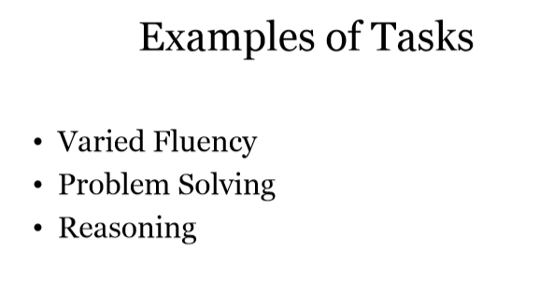

Slide 10
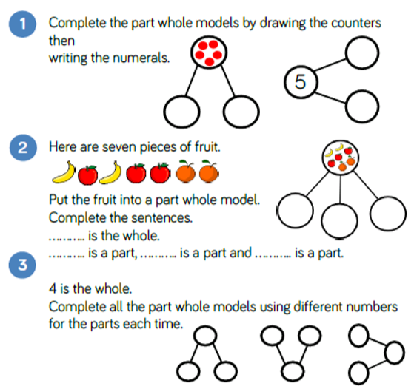
Example of Year One Fluency relating to addition
Example of a stem sentence. We also encourage children to think about generalisations that will support their maths. E.g. always start from the right hand column when you are doing column addition to prepare for exchanging.

Slide 11
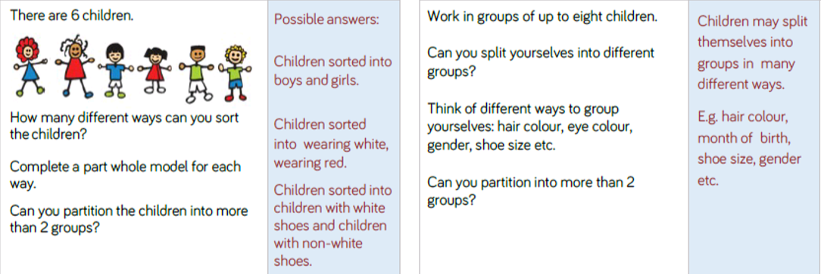
Examples of reasoning and problem solving for Year One , related to addition.

Slide 12
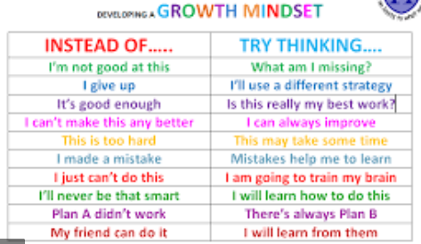
Growth Mindset
Success in mathematics for every child is possible
• Mathematical ability is not innate, and is increased through effort.

Slide 13
How can I become involved?
• Talk to your child about their learning, what have they learned in their maths lessons? Can they show you?
• Discuss numbers all around you: door numbers, bus numbers etc.
• Cooking and shopping with your child, getting them to weigh ingredients, using language such as “more” and “less/fewer”.
Model having a growth mindset – please don’t tell them you ‘can’t/could never do maths at school’.
Please help your children to learn their number bonds and times tables so that they can quickly recall them. This can be through the use of NUMBOTS, TTRS and/or non screen-based activities.

Slide 14
Finally…
We would absolutely love you to come in and talk to the children about how you use maths in your day-to-day life and jobs.
If you would like to volunteer to be involved please let us know!
Please help yourself to the handouts and if you have any questions please do feel free to speak to your child’s class teacher or me!
Thank you for coming!

